Slide 1
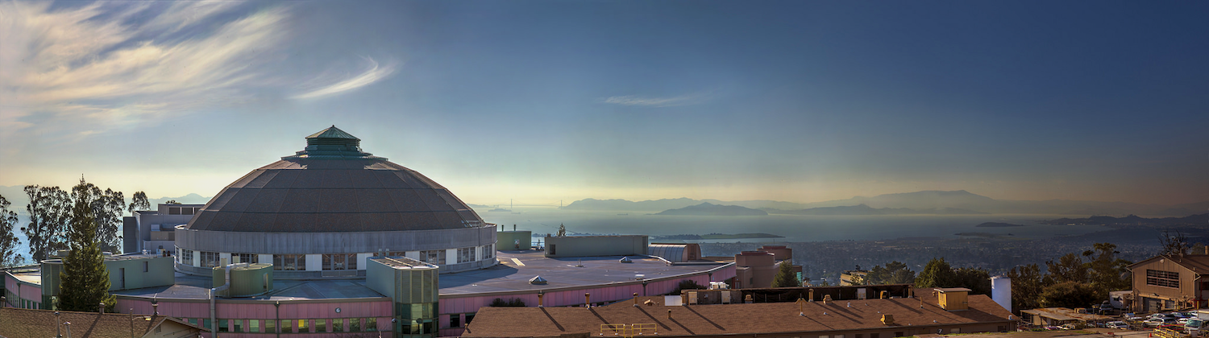



Introduction to COMSYL
Manuel Sanchez del Rio
srio@lbl.gov

Slide 2
COMSYL
Coherent Modes of Synchrotron Light
(calculates the coherent modes for undulators in storage rings)

Slide 3
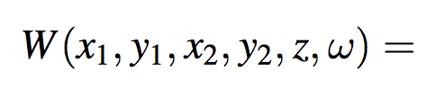
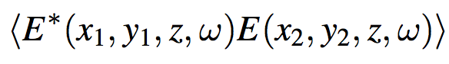
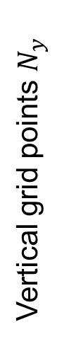
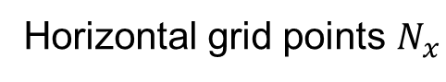
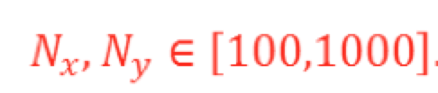
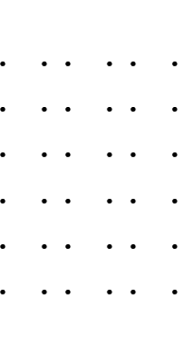
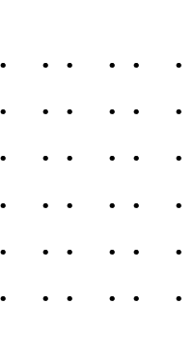
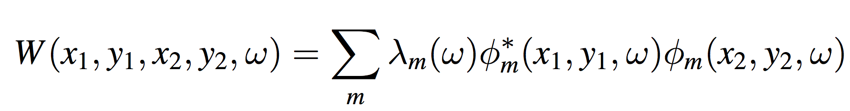
W ~ 10⁸ – 10¹² (Gb-Tb)
Propagate: 4D integrals
4D function
2D functions
Store m x N x N Propagate: 2D integrals

Slide 4
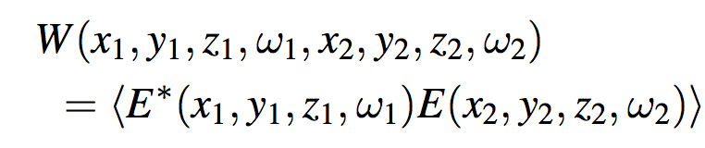
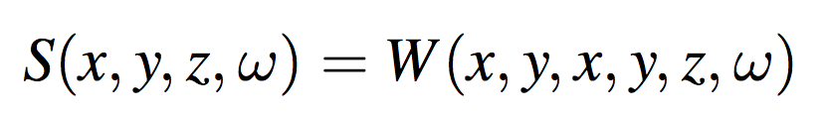
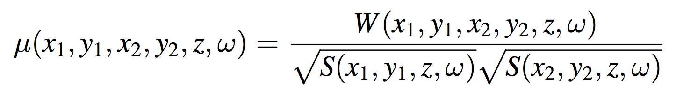
Cross Spectral Density
Mutual Coherent Function (t-dependency) or Cross Spectral Density (ω-dependency)
8D function that propagates using a double wave equation
Spectral Density “intensity”
Spectral Degree of Coherence
Wide sense stationary: W≠0 if ω₁=ω₂=ω Long bunch length, high ω , not to small Δω Geloni et al. NIM A 588 463 (2008)
Decoupling z: 4D function (for given z and ω)
W ~ 10⁸ – 10¹² (Gb-Tb)
Propagate: 4D integrals
4D function
2D functions

Slide 5
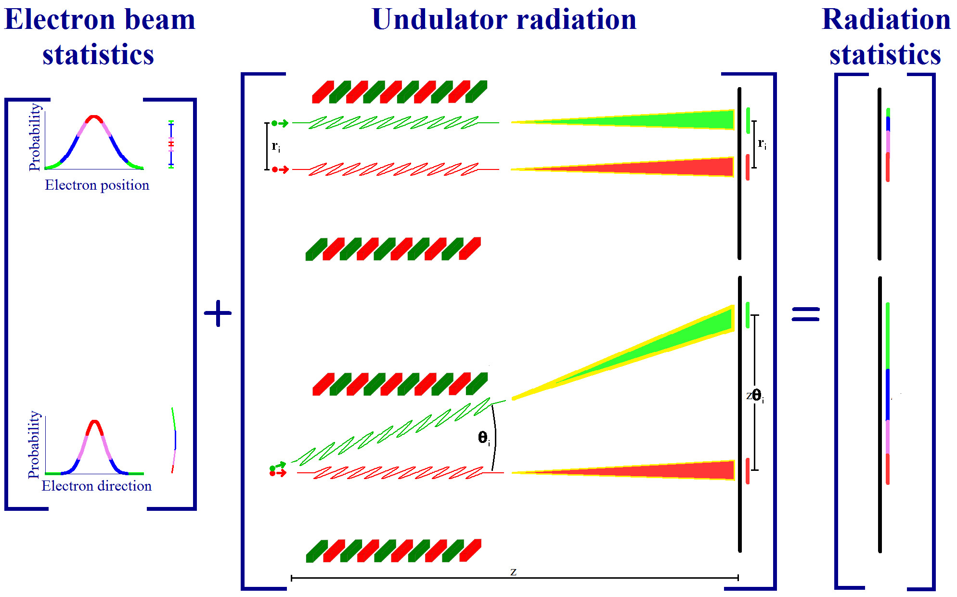
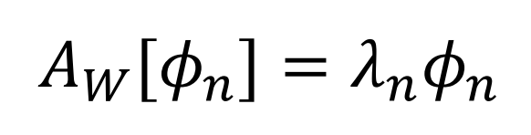
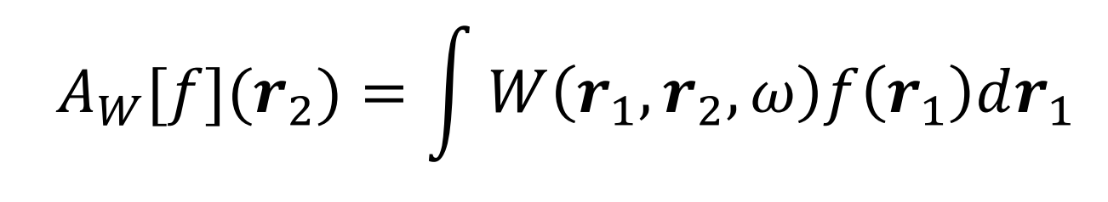
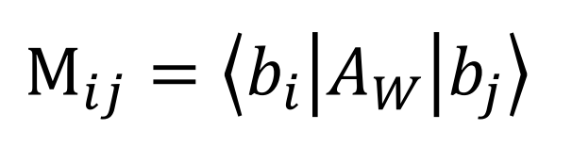
COMSYL (Coherent Modes for Synchrotron Light)
COMSYL https://github.com/mark-glass/comsyl
Glass & Sanchez del Rio (2017) EPL 119 p 34004
Undulator
radiation
Calculate CSD
Coherent mode decomposition
SRW
K.-J. Kim Proc. SPIE 0582 (1986)
OASYS
Friedholm equation:
Propagate CSD along the beamline
Diagonalize M with iterative solver slepc
Large memory.
Parallel computers using MPI.
Large clusters (ESRF). Cloud computing (AWS, etc.)
Rediagonalize CSD

Slide 6
Info COMSYL
Repository: https://github.com/mark-glass/comsyl
Installation: https://github.com/mark-glass/comsyl/wiki
Paper: http://dx.doi.org/10.1209/0295-5075/119/34004 Mark Glass, Manuel Sanchez del Rio (2017) Coherent modes of X-ray beams emitted by undulators in new storage rings EPL (Europhysics Letters) 119

Slide 7
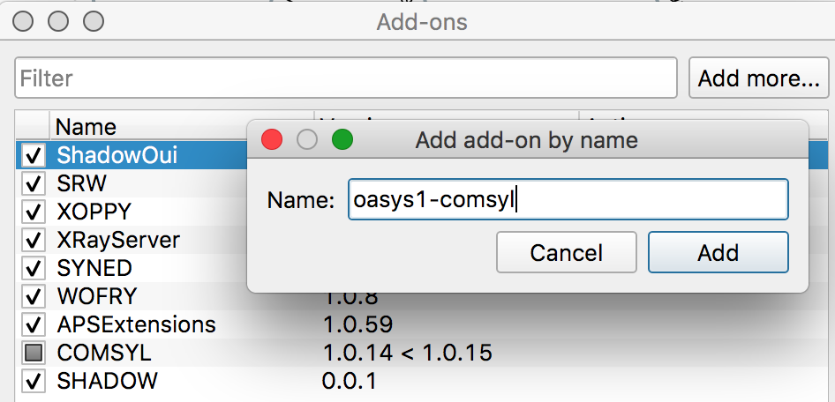
Install Comsyl-Oasys (not for COMSYL calculations, only for displaying and propagating results)
Add-on
Download 2 files (one BIG!!) from: https://anl.box.com/s/l9grzeul9d445eb1lijhxbkw46zdlkry or https://tinyurl.com/vcm6k2p

Slide 8

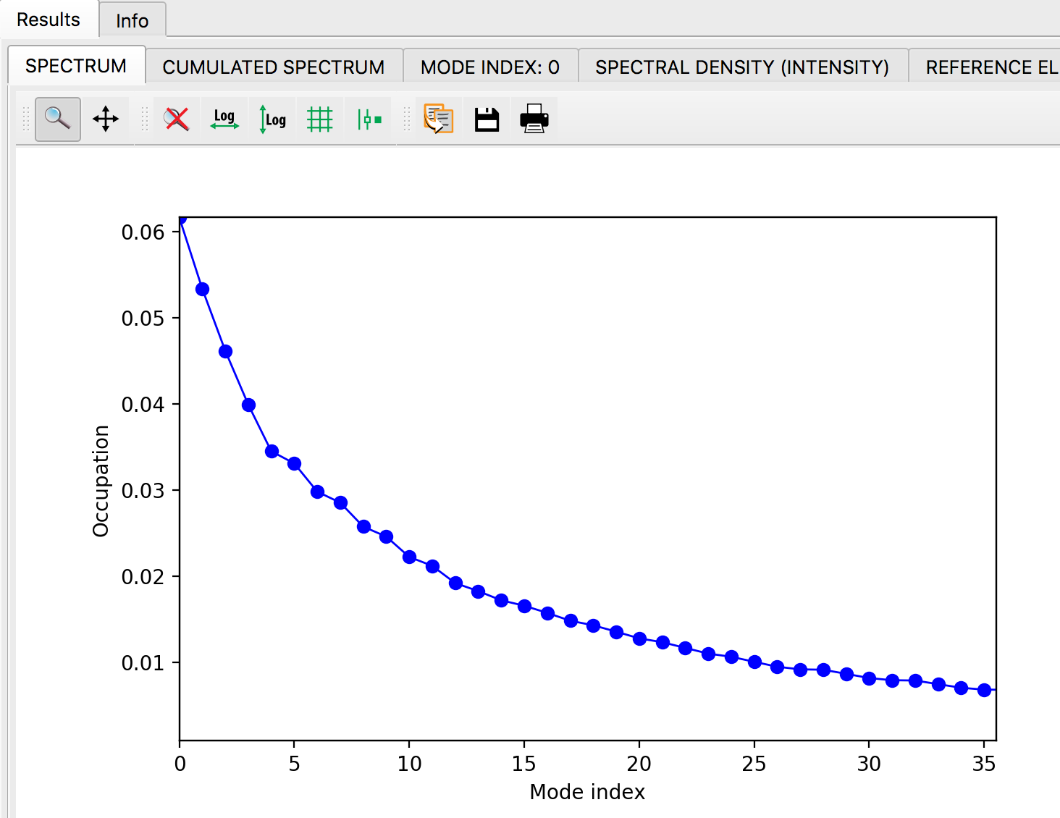
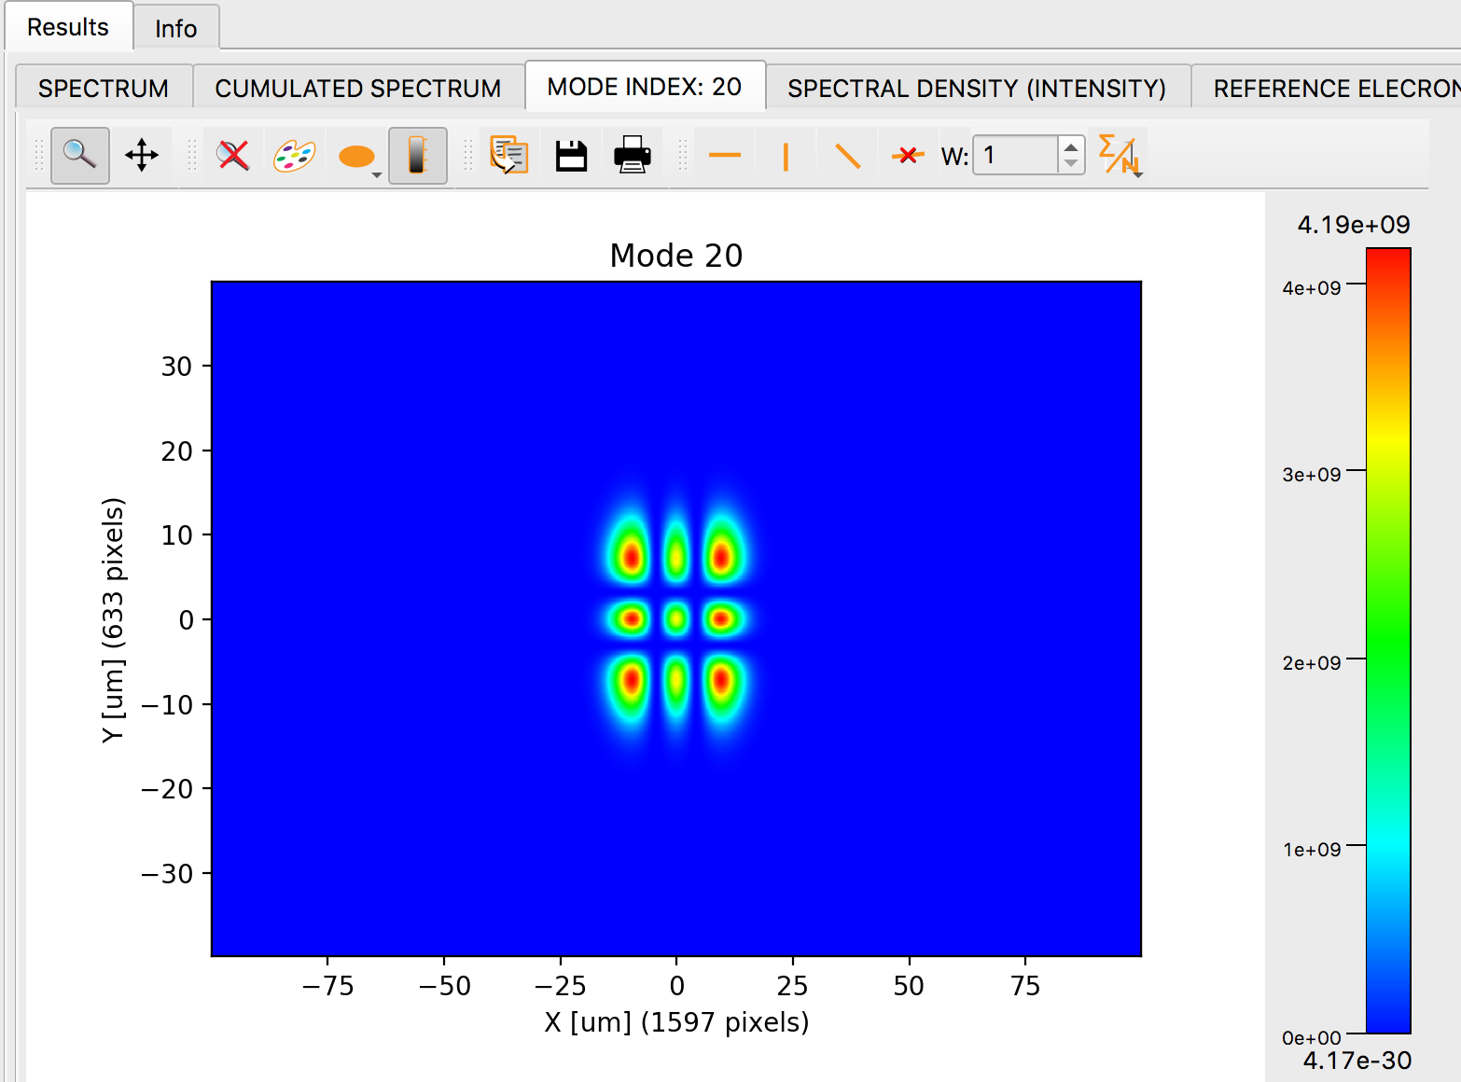
OASYS-COMSYL
Read and visualize COMSYL calculations
﻿Undulator ISN 25KeV: ﻿u_25keV_s10.0.npy

Slide 9
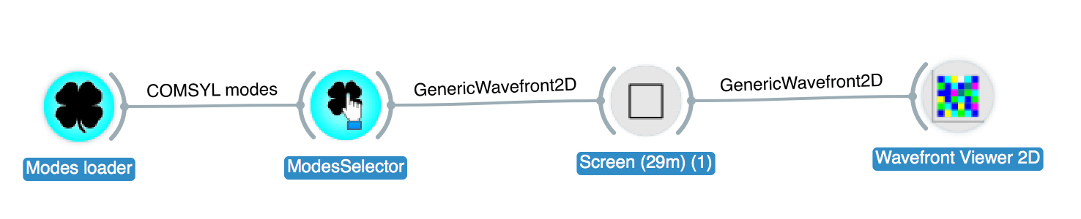
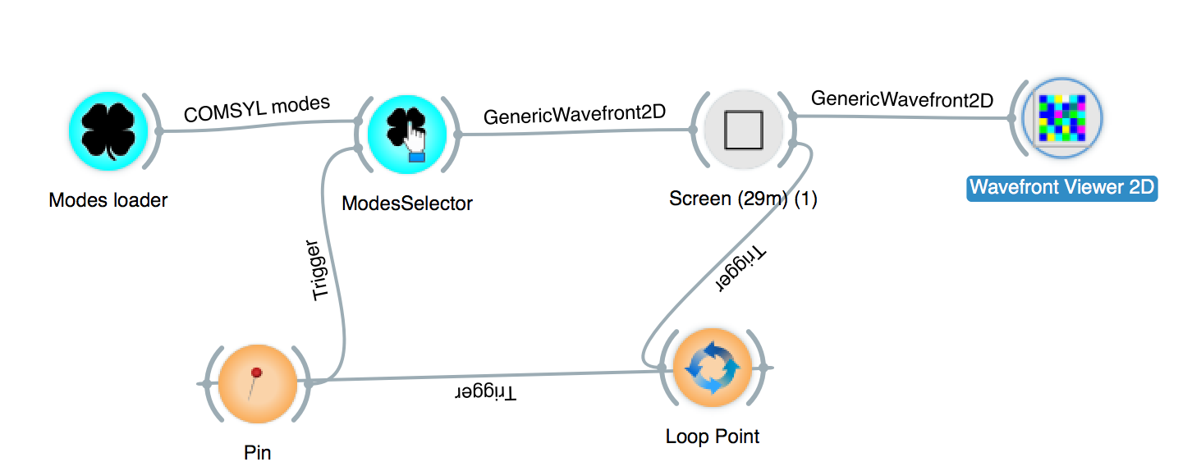
OASYS-COMSYL
WOFRY
Extract wavefronts to propagate with WOFRY or SRW
Loop over number of modes:

Slide 10
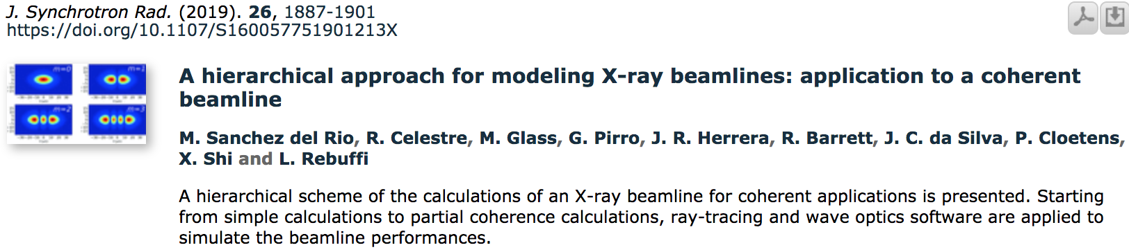
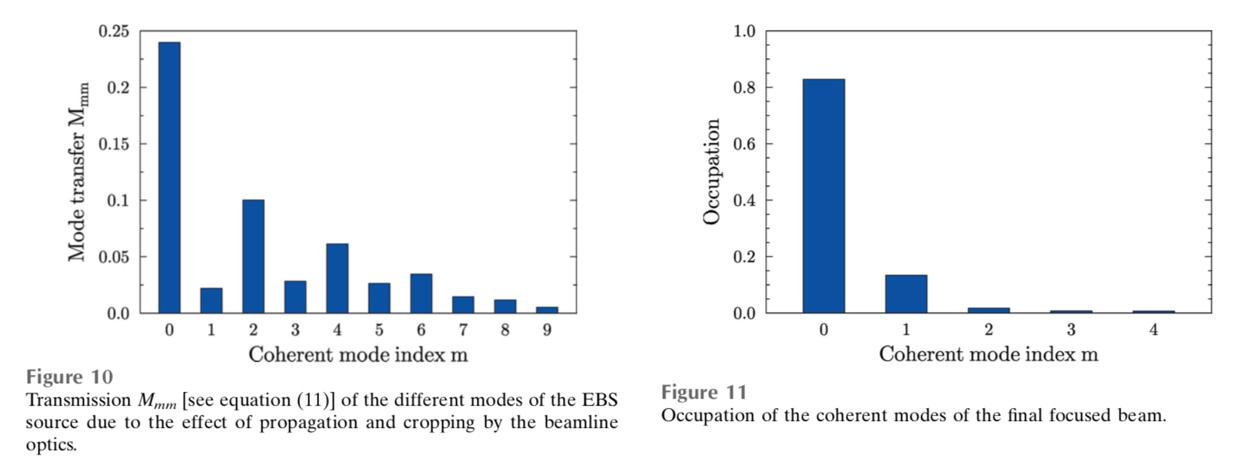
COMSYL: ESRF ID16A
After recalculate modes (rediagonalization)
Just propagation

Slide 11
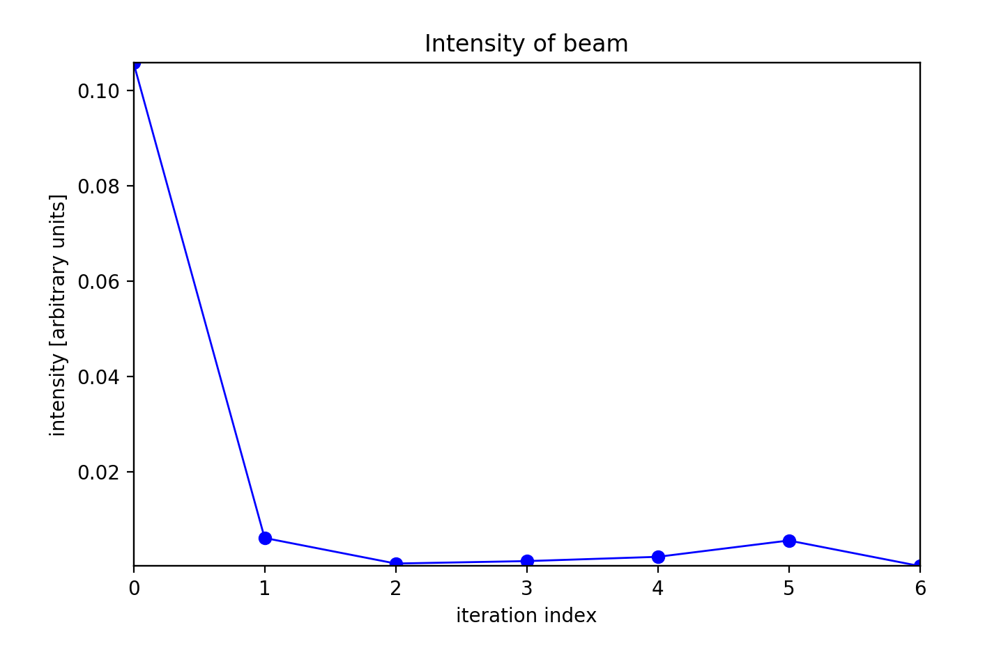
Mode transmission for ISN (draft!)

Slide 12
Exercise
Couple COMSYL models with ISN beamline:
WOFRY
SRW (real optics, surface errors)
Rediagonalize beam at focal position to compute coherent fraction

Slide 13
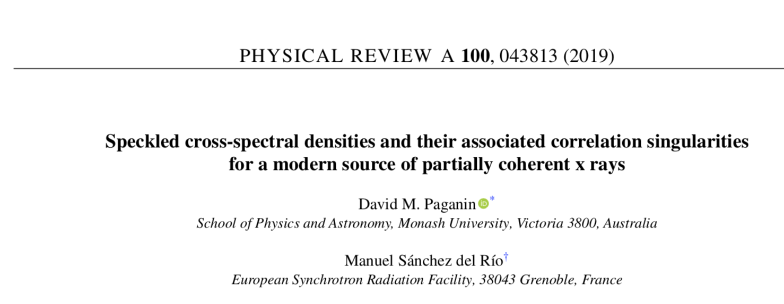
Advanced use of COMSYL Study of singularities in W

Slide 14
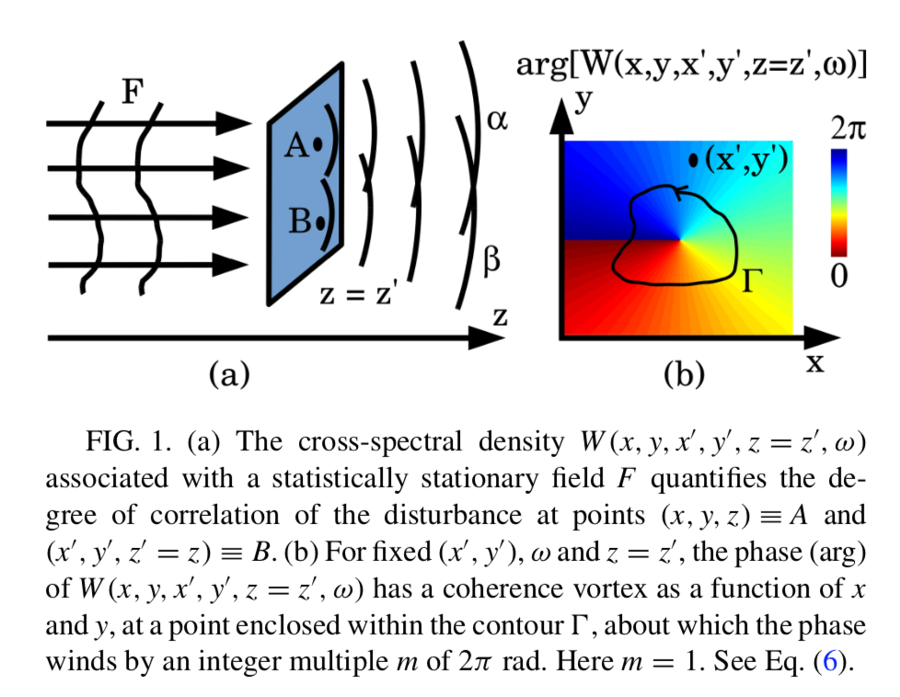
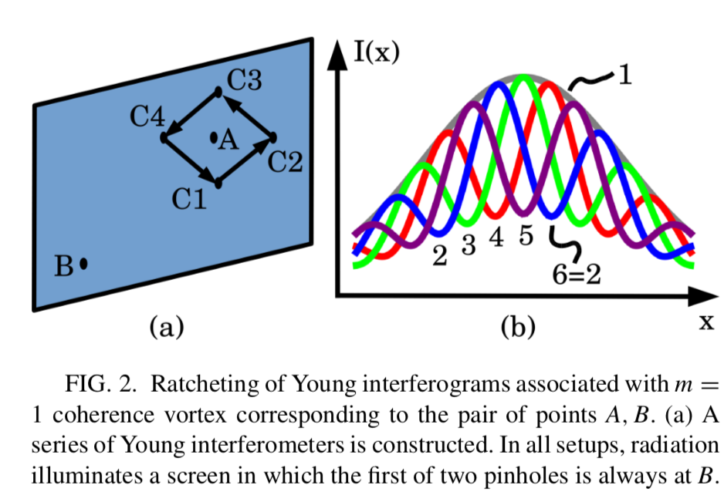
Role of the phase of CSD

Slide 15
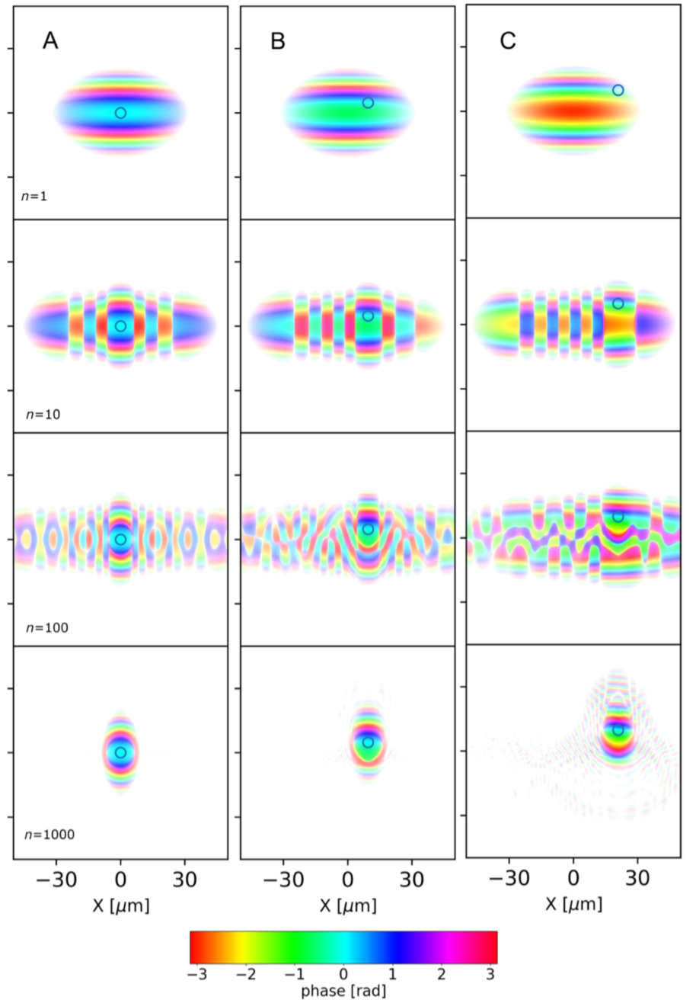
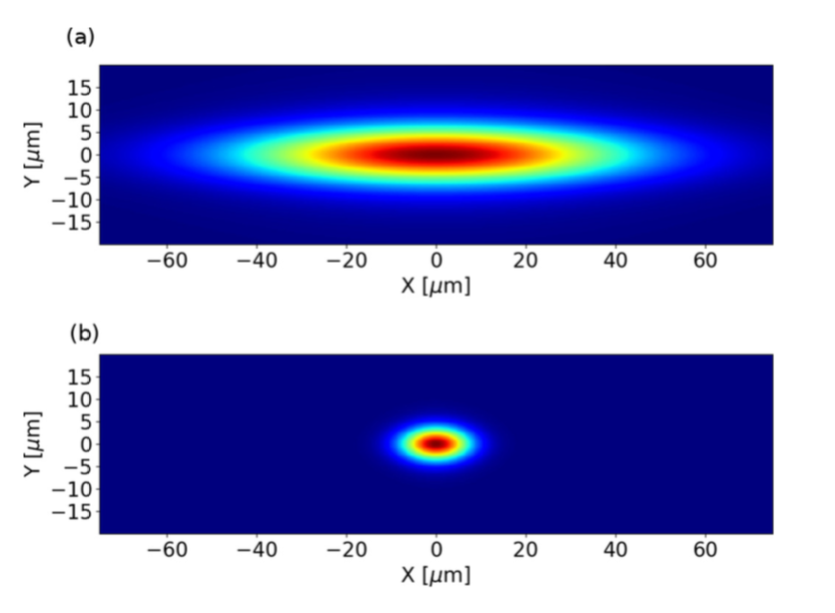
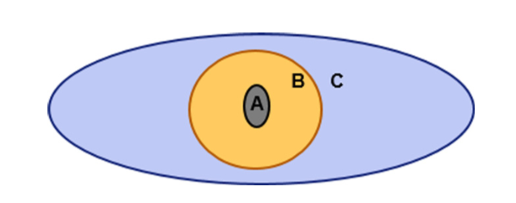
Arg[W] at Source position
Spectral Density
First coherent mode
Position of the fixed point

Slide 16
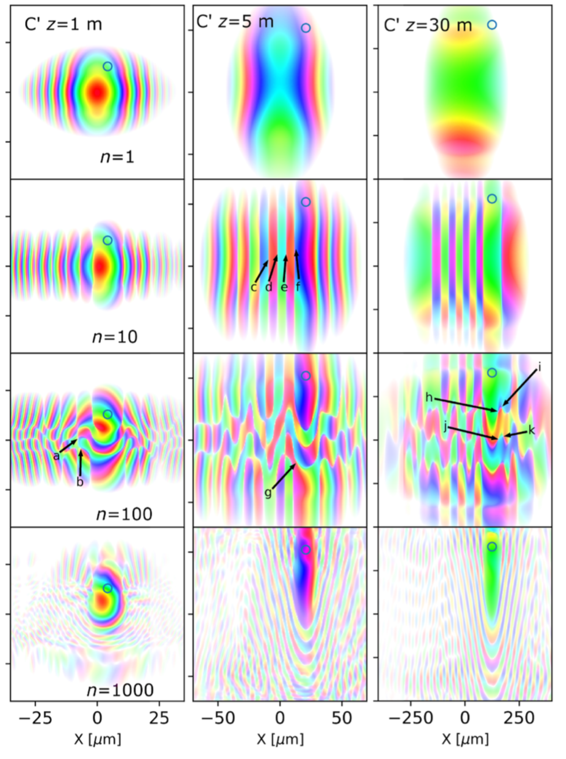
Propagated

Slide 17
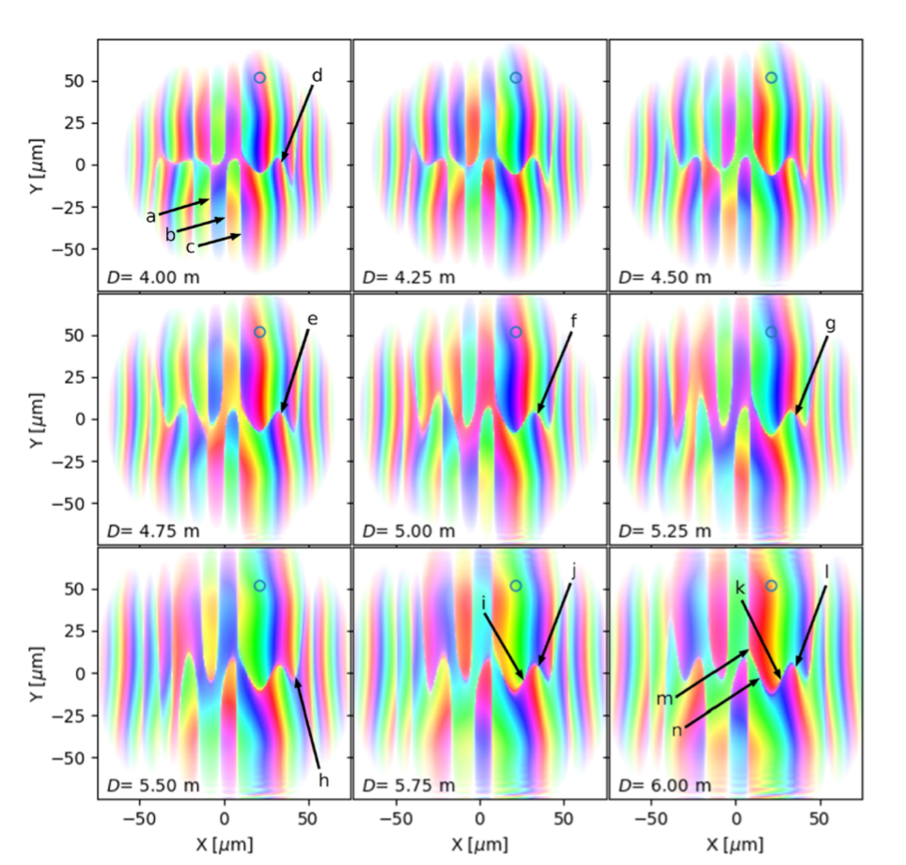
Dynamics of singularities
Coherence domain walls a, b, c
Coherence vortices: d , e, f , g, h
Vortex-antivortex pair i j is nucleated in passing from D = 5.50 m to D = 5.75 m

Slide 18
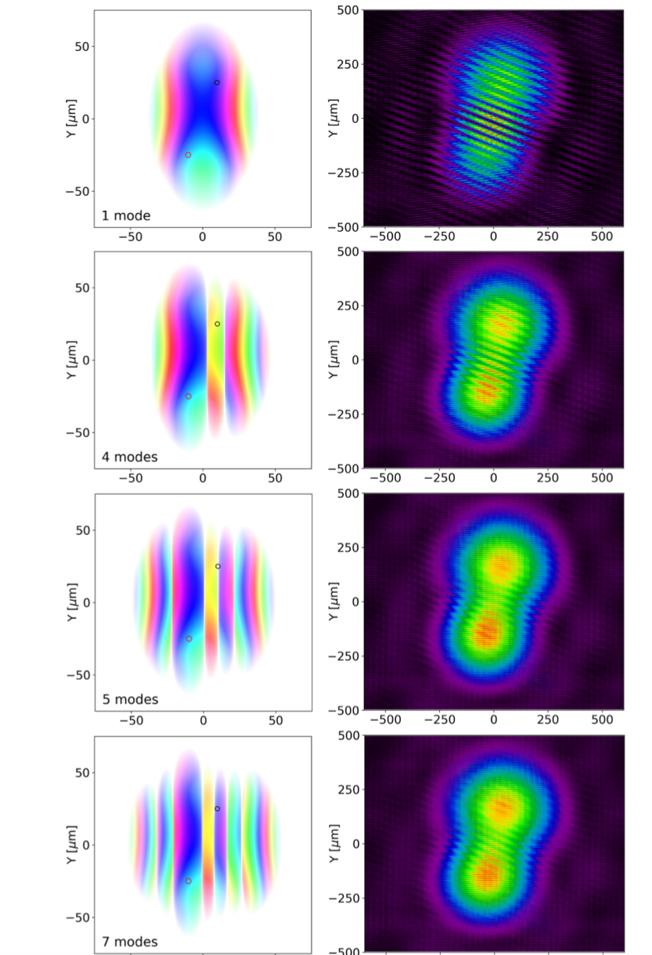
Visibility vs coherence
Coherence vortices and domain walls will exist in many nontrivial x-ray fields. Such correlation singularities influence the images that one takes, in ways that may lead to misleading results if one simply ignores their existence. Correlation singularities were seen to be present in the field generated by a modern x-ray undulator. Such singularities, which are not present in many simple models for partially coherent sources, were seen to imply a speckled structure in the associated cross-spectral density.

Slide 19
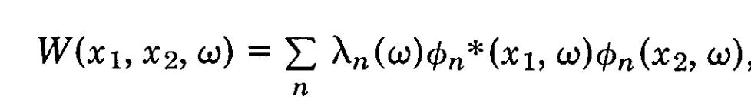
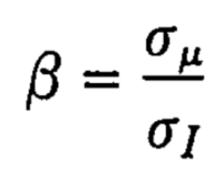
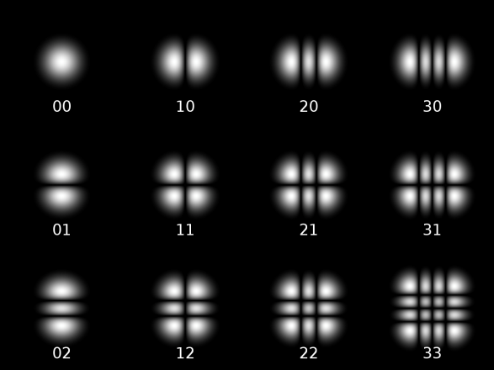
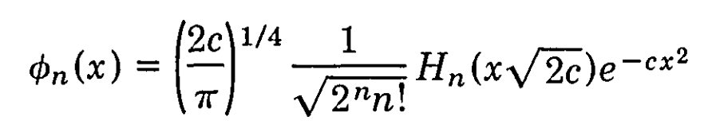
Gaussian Shell-Model
Both intensity (Spectral Density) and correlation (Spectral Degree of Coherence) are Gaussians
σ_{I}>>σ_{μ} the source is mostly incoherent (quasi homogeneous)
σ_{I}<<σ_{μ} is mostly coherent
I
I
Eigenvalues
Eigenfunctions
(Hermite-Gaussian modes)
Magic property: Propagation invariance
In the first mode (Gaussian) :
In 2D (H x V)
2D Hermite-Gaussian or
TEM_{nm} modes

Slide 20
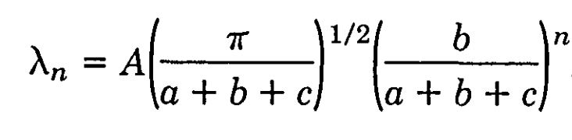
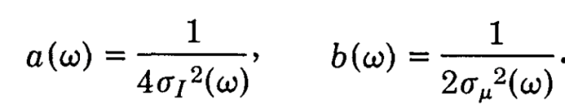
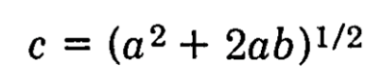
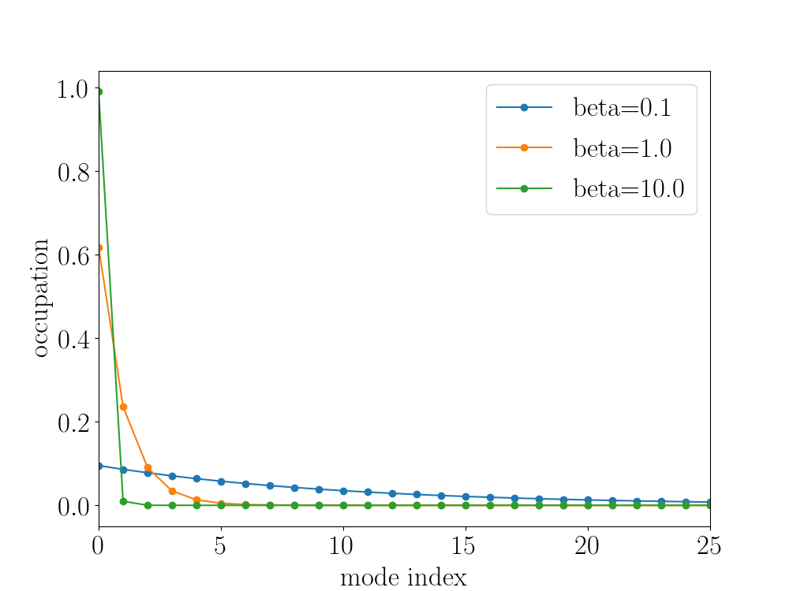
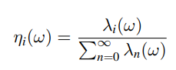
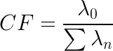
The spectrum of coherent modes
Eigenvalues
Mode occupation:
Coherent: β>>
Coherent fraction:
incoherent
β<<
In general we cannot apply Gaussian Shell-model to synchrotron

